Slide 1
LEGO Project
Dario Brandt
Technical writing
Professor J Loan
Notes:
© Copyright Showeet.com

Slide 2
Rocket Platform
Concept step by step instruction
Notes:
© Copyright Showeet.com

Slide 3

Parts
1x (6x10)
1x
(6x6)
1x
(2x4)
1x
(1x1)
6x
(1x2)
6x
(1x1)
16 pieces set
Notes:
© Copyright Showeet.com

Slide 4
Have Fun!
Build by following picture instructions
Notes:
© Copyright Showeet.com

Slide 5
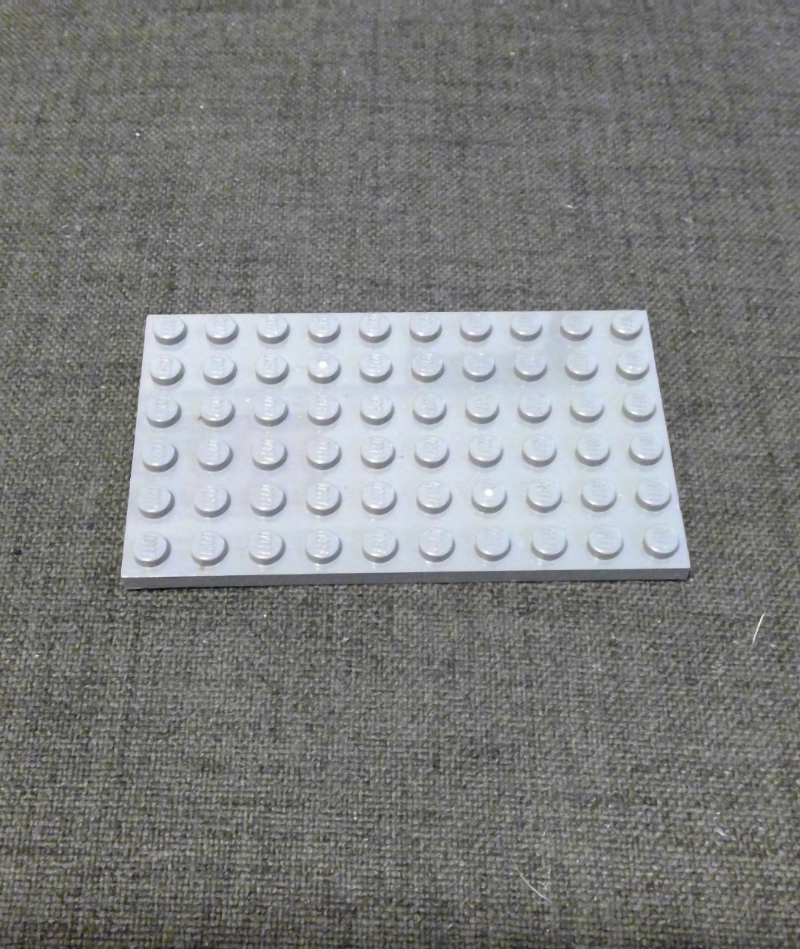
Every new adventure starts with the first step
Step 1
Notes:
© Copyright Showeet.com

Slide 6
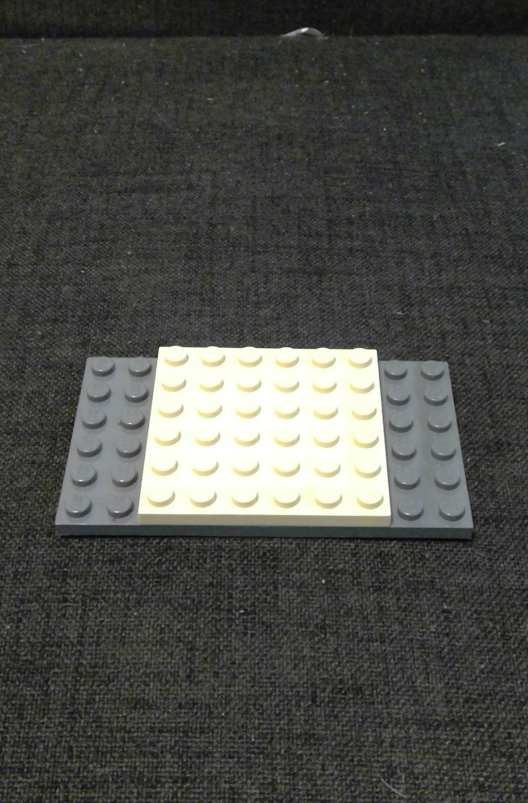
Two stepping!
Step 2
Notes:
© Copyright Showeet.com

Slide 7
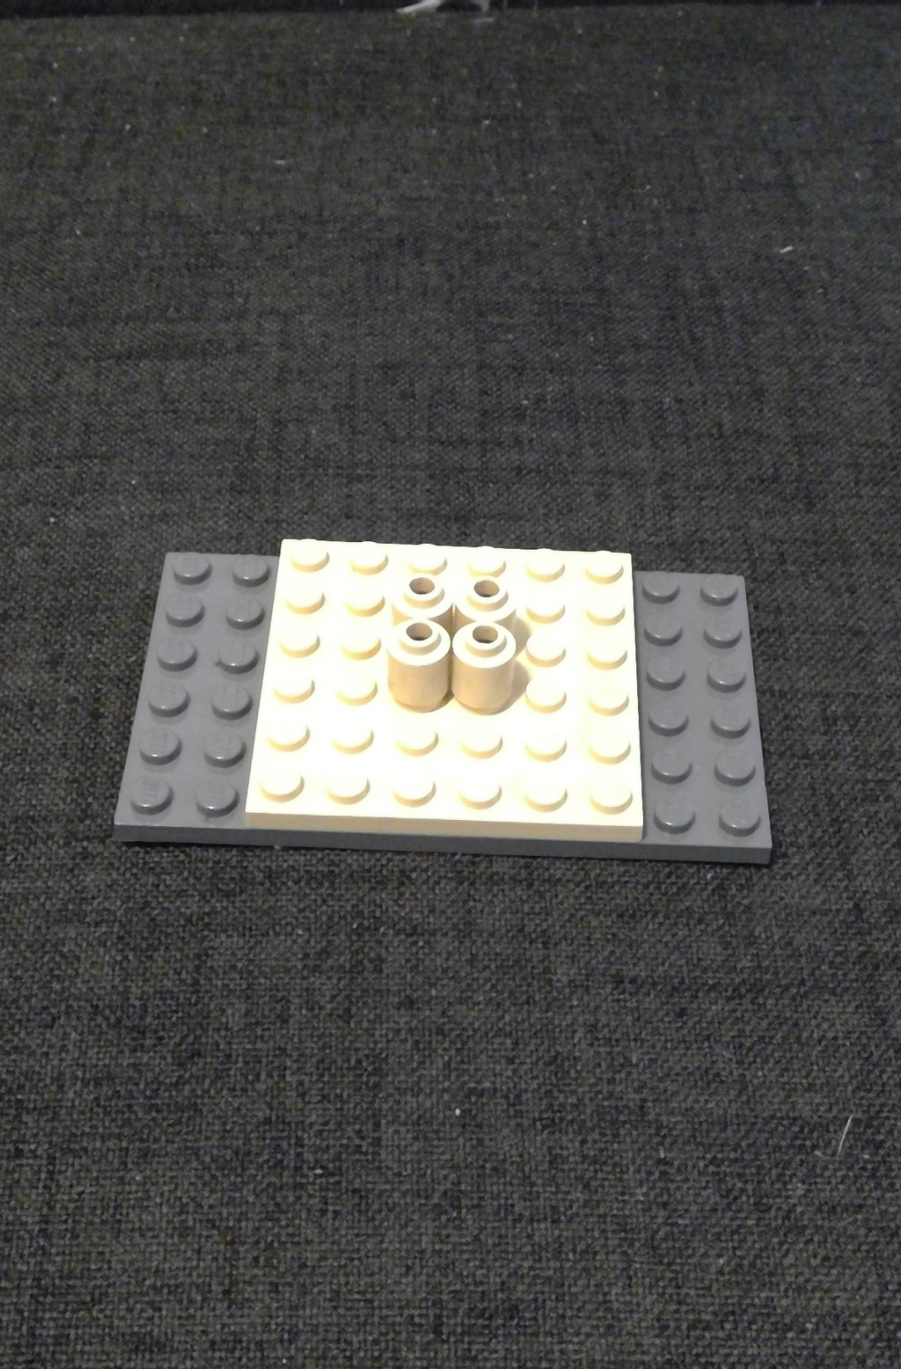
Third times a charm
Step 3
Notes:
© Copyright Showeet.com

Slide 8
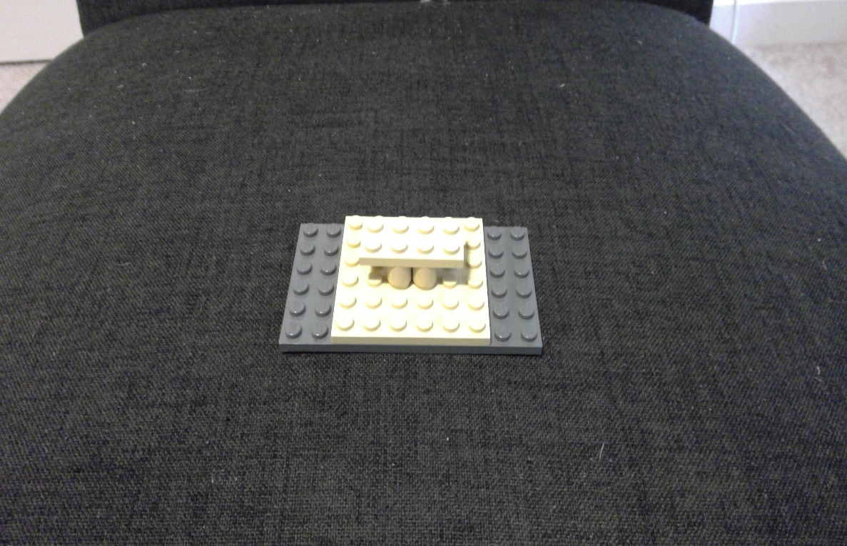
Fooooooouuuuuuurrrr!!!!
Step 4
Notes:
© Copyright Showeet.com

Slide 9
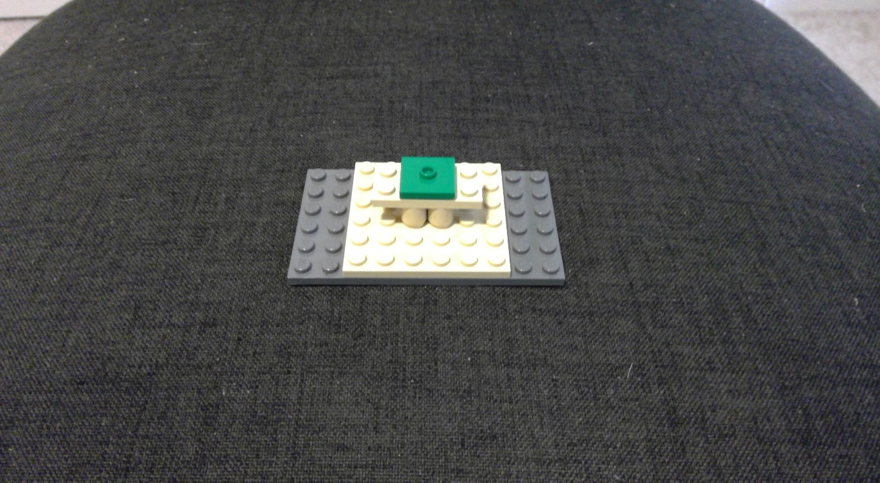
I got five on it
Step 5
Notes:
© Copyright Showeet.com

Slide 10
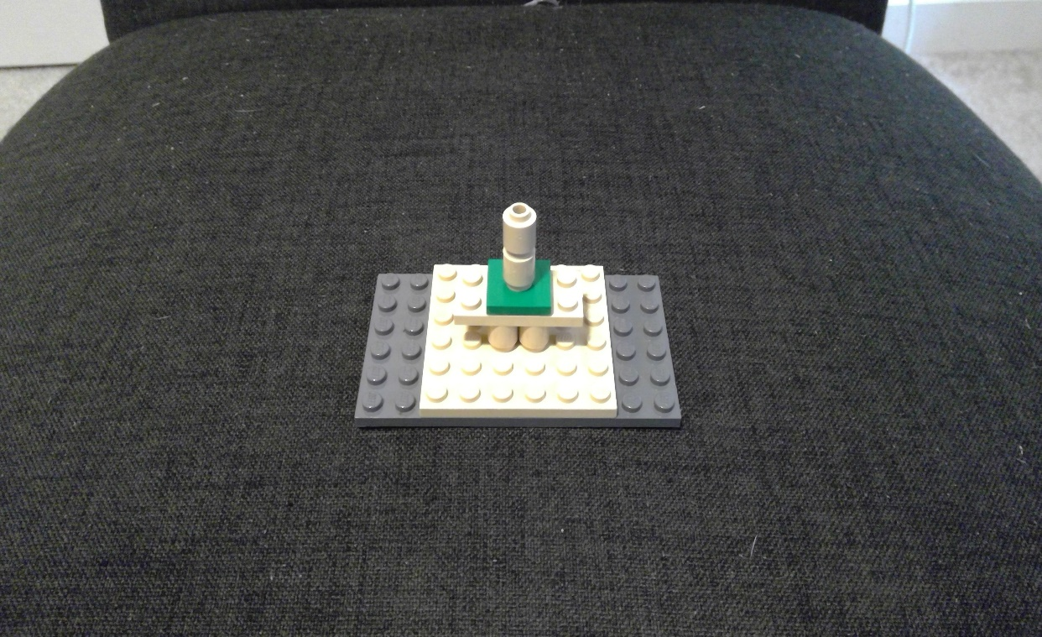
Six is a magic number
Step 6
Notes:
© Copyright Showeet.com

Slide 11
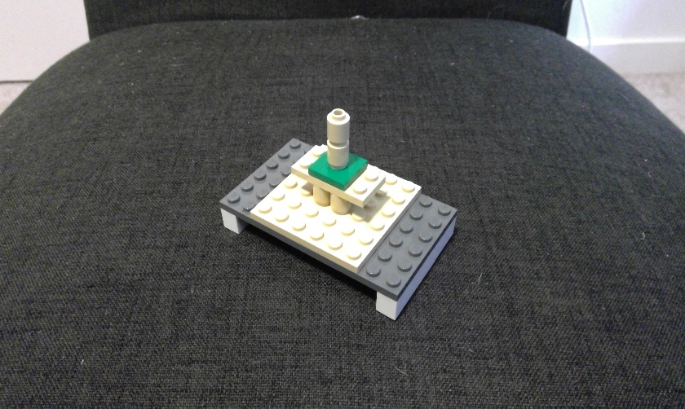
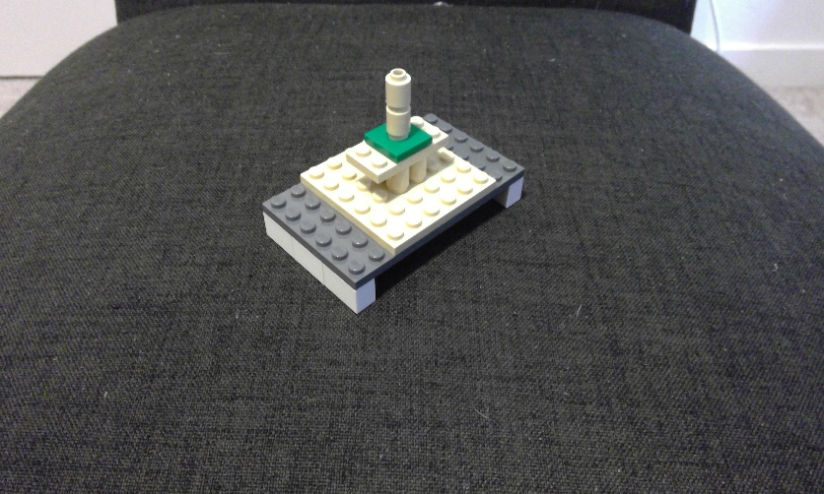
7 minutes till take off
Step 7
Notes:
© Copyright Showeet.com

Slide 12
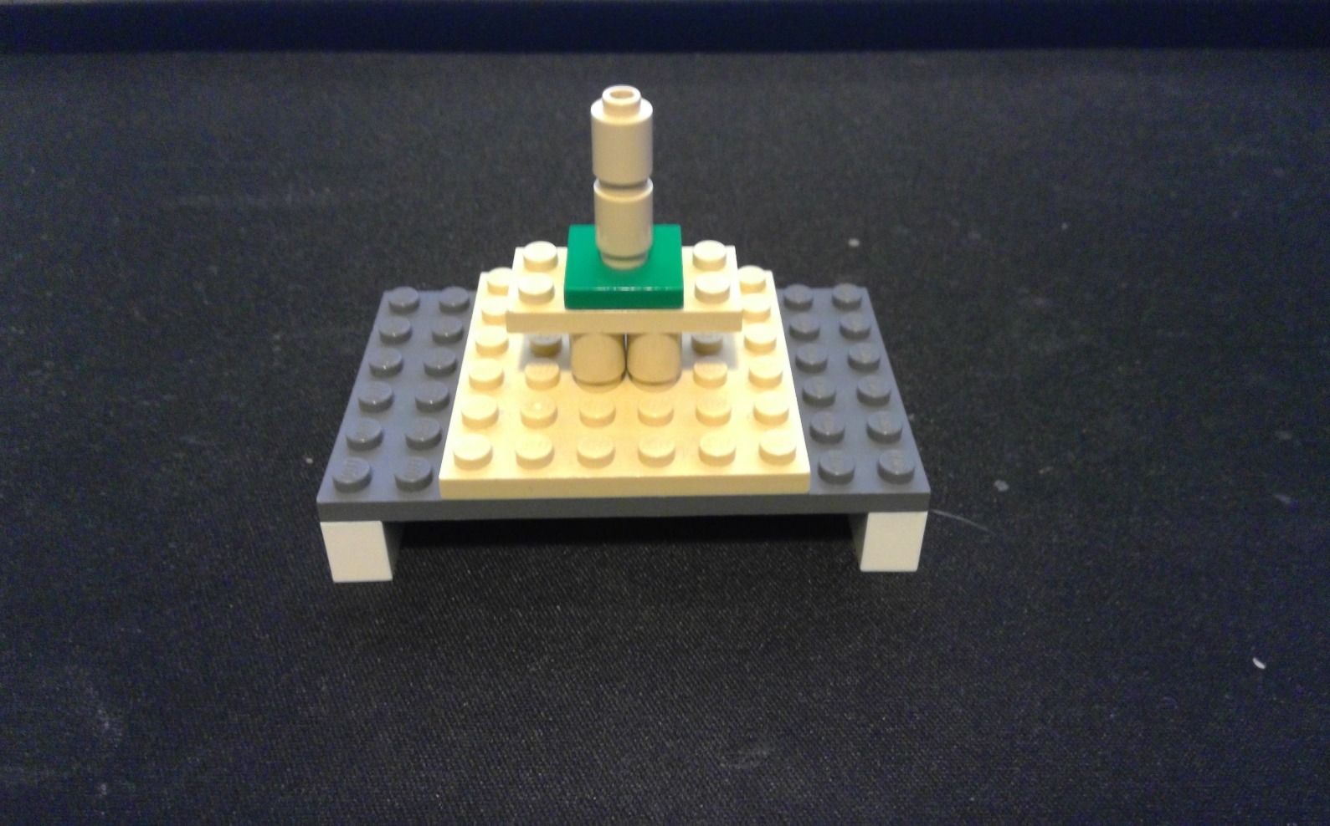
Ready to blast into space
Notes:
© Copyright Showeet.com

Slide 13
LEGO® parts (editable & grouped) – 1/5

Slide 14
LEGO® parts (editable & grouped) – 2/5

Slide 15
LEGO® parts (editable & grouped) – 3/5

Slide 16
LEGO® parts (editable & grouped) – 4/5

Slide 17
LEGO® parts (editable & grouped) – 5/5

